Slide 1
Parsing UCS logs on BDB
Group No: G45 Date:06/07/2015
Project Guide : Mrs. Padmavathi .S
S.No | Reg.No | Name of the Student | Section
1. | CB.EN.U4CSE11439 | E. Rahul | CSE - E

Slide 2
Problem Statement
  Tech support files sent by the customer contain large amounts of data, TAC engineer must manually read each file to extract relevant information.
Date: 06-07-2015
Project Group No: G45

Slide 3

What is UCS?
UCS is a server that is part of Cisco’s Unified Computing System
There are two types of UCS servers:
  B series (blade servers)
  C series (stand alone rack servers)
Date: 06-07-2015
Project Group No: G45

Slide 4
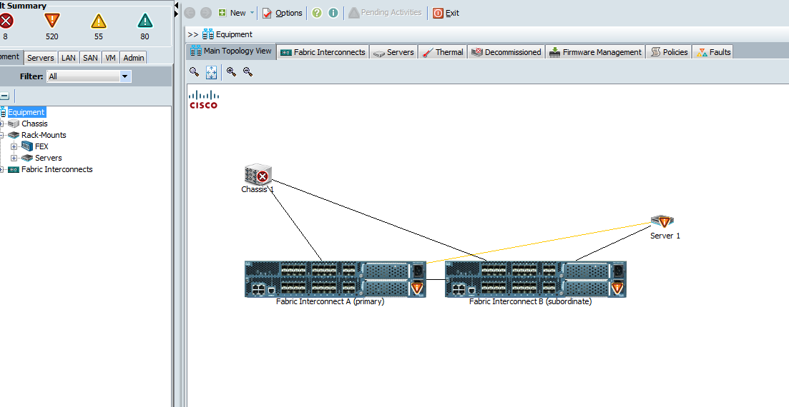
Architecture of UCS
Date: 06-07-2015
Project Group No: G45

Slide 5
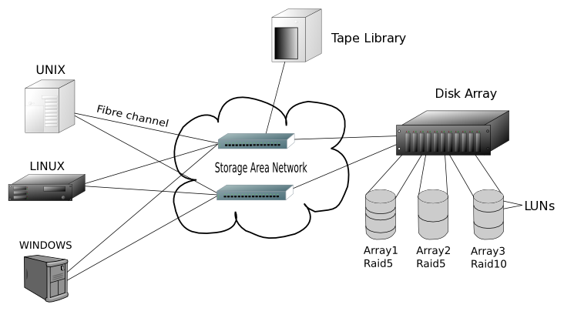
System Design
Date: 06-07-2015
Project Group No: G45

Slide 6
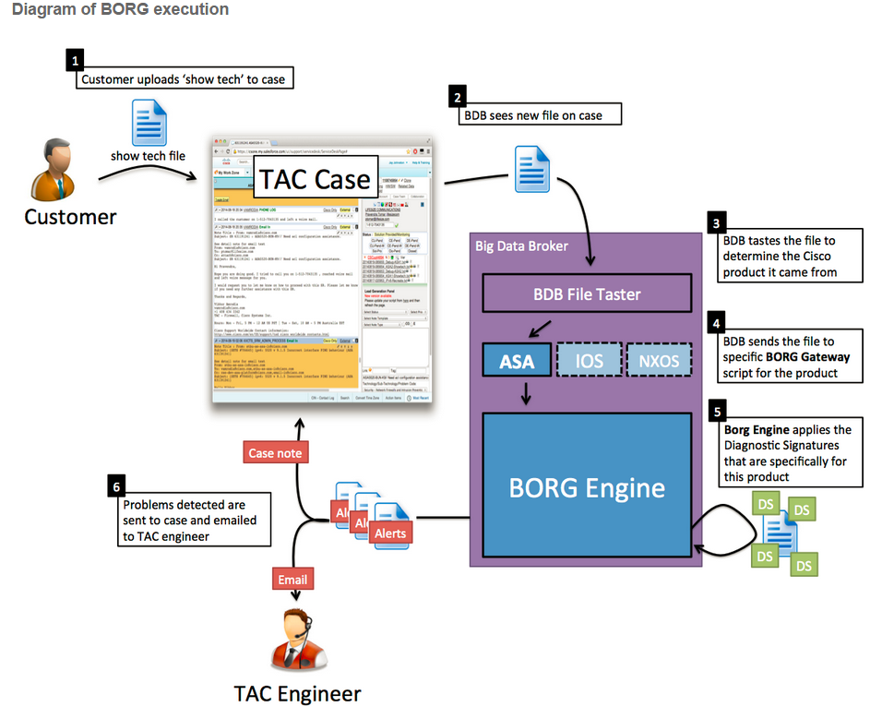
Automation
Date: 06-07-2015
Project Group No: G45

Slide 7
Module 1
Input file validation
  Detect C series rack server tech support file and if found, run the program
  Else, display an informational message
  Status: Complete
Date: 06-07-2015
Project Group No: G45

Slide 8
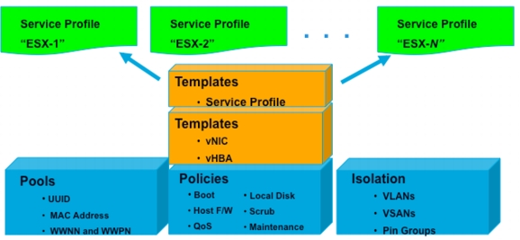
Module 2
Service profile details
  List out the number of service profiles under each organization
  The service profiles and their parent templates
  Display the templates along with their type
  Status: Complete
Date: 06-07-2015
Project Group No: G45

Slide 9
Module 3
Fiber Channel details
  Extract the NX-OS version and UCSM version
  Determine the FI mode of operation
  Show the uplink port status
  Status: Complete
Date: 06-07-2015
Project Group No: G45

Slide 10
Implementation
CISCO BDB
UCS-service-profile
UCS-FC-config-report
UCS-LAN-config-report
Date: 06-07-2015
Project Group No: G45

Slide 11
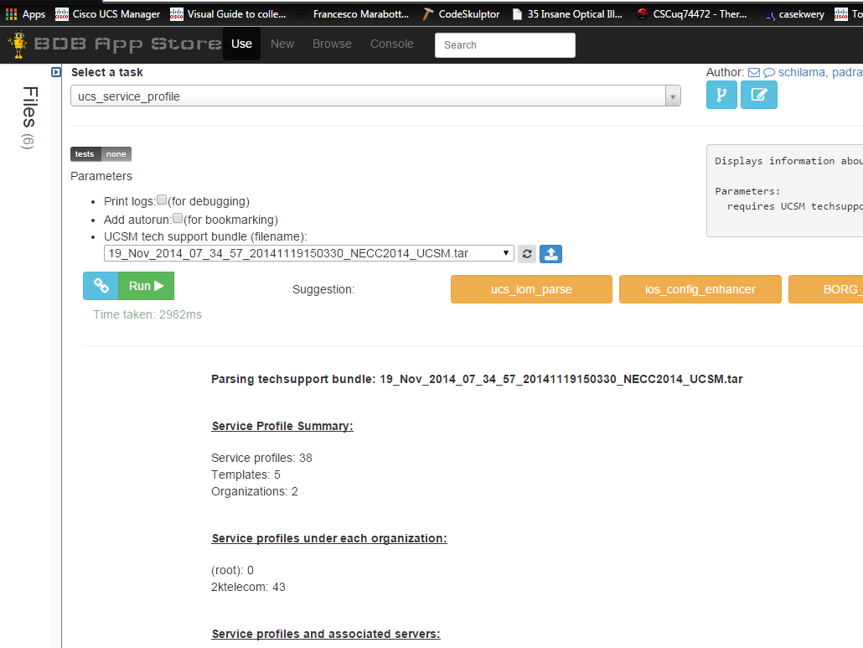
Service profile
Date: 06-07-2015
Project Group No: G45

Slide 12
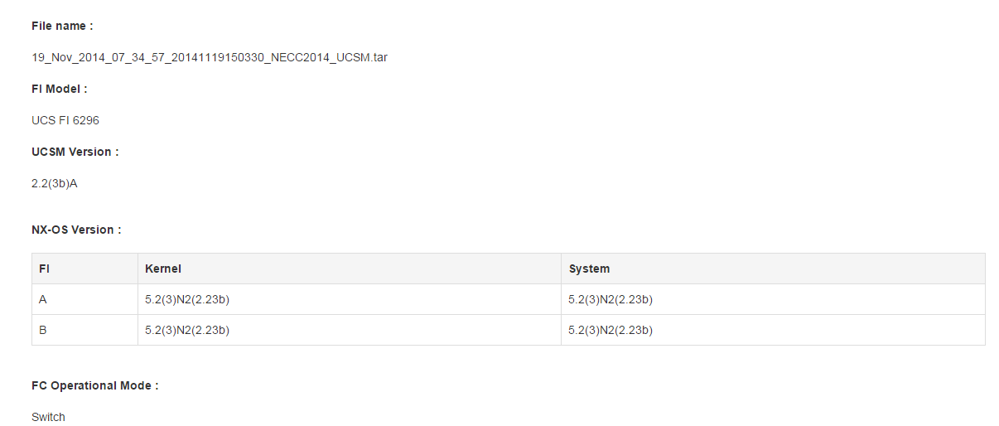
UCS-FC-config-report
Date: 06-07-2015
Project Group No: G45

Slide 13
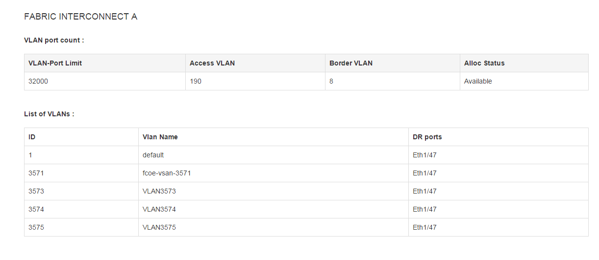
UCS-LAN-config-report
Date: 06-07-2015
Project Group No: G45

Slide 14
Scope for future work
To parse LAN details.
To parse N1K details.
Automation of both the parsers
Date: 06-07-2015
Project Group No: G45

Slide 15
References
“An Introduction to Firewalls ” ,
Available : http://www.cisco.com/c/en/us/support/docs/security/asa-5500-x-series-next-generation-firewalls/108000-dap-deploy-guide.html
“Service profile and their templates”
Available: http://www.cisco.com/c/en/us/td/docs/security/asa/asa91/configuration/general/asa_91_general_config.html
“Fabric Interconnect”
Available:
http://www.cisco.com/c/en/us/td/docs/security/asa/asa91/configuration/general/asa_91_general_config.html
Date: 06-07-2015
Project Group No: G45

Slide 16
Thank you!
Date: 06-07-2015
Project Group No: G45

